Slide 1

CAN Project: Console App
Belgium Campus 2024/07/18 Cna 271

Slide 2
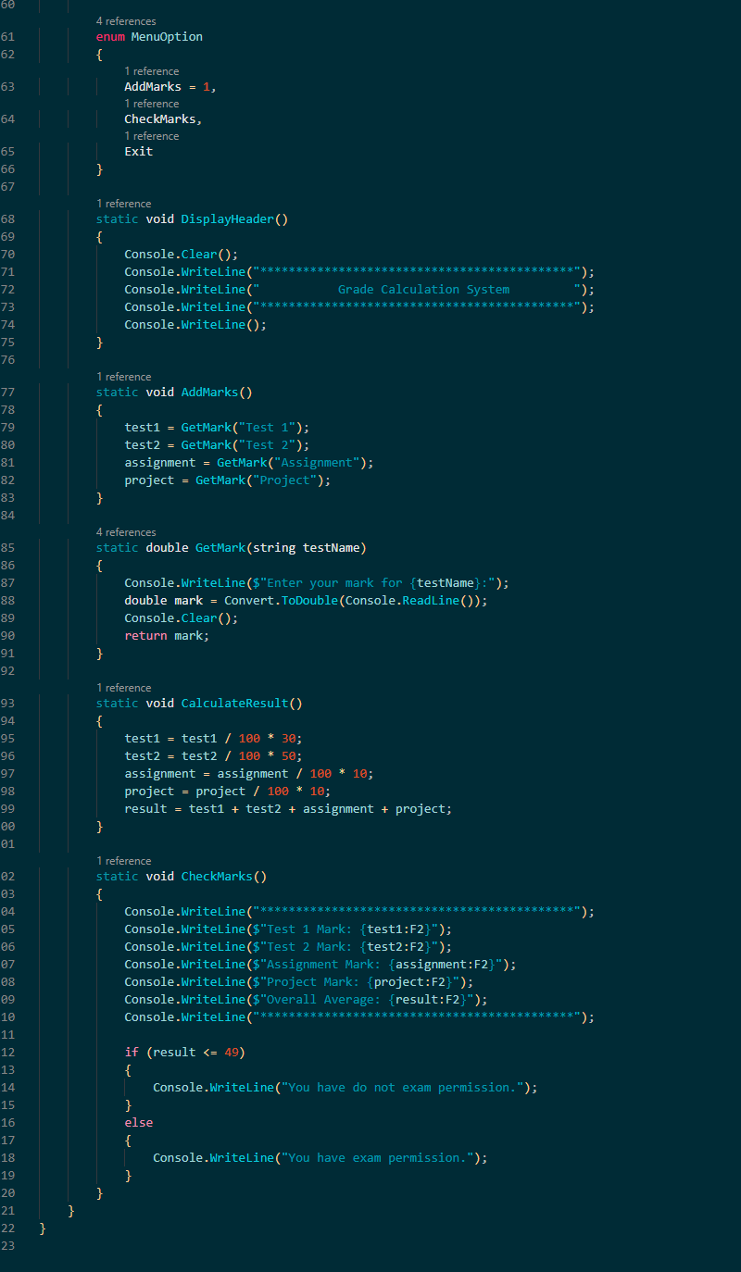
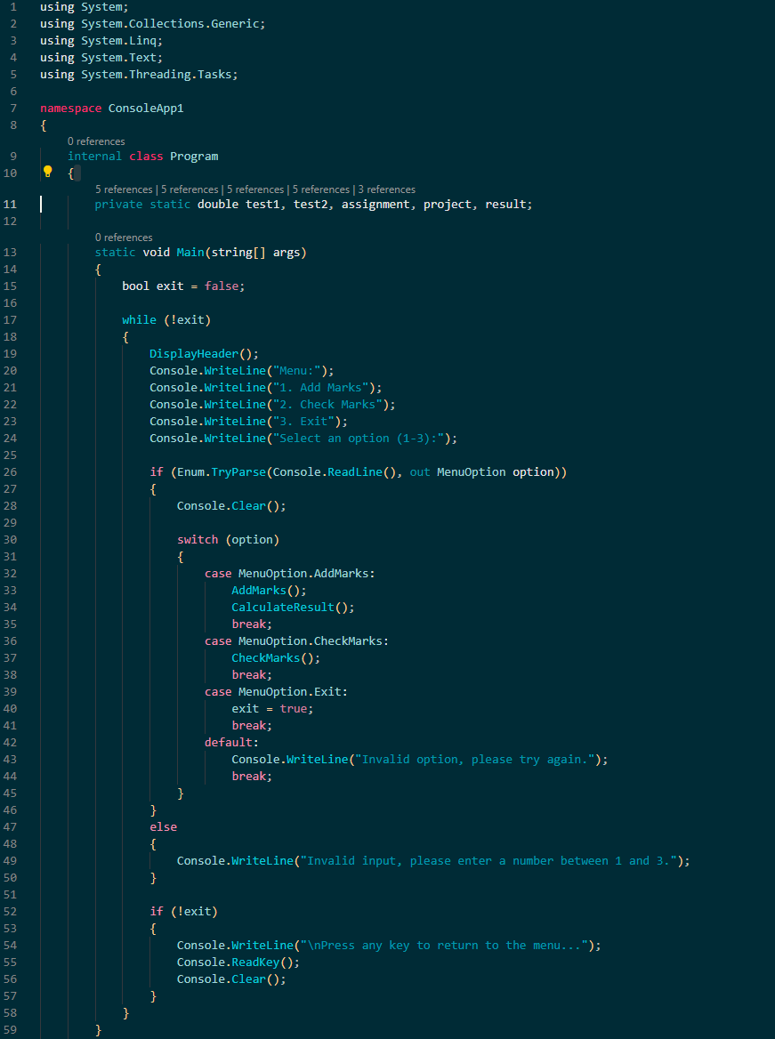
Base code : C#
Belgium Campus 2024/07/18 Cna 271

Slide 3
Base code : C#
Belgium Campus 2024/07/18 Cna 271

Slide 4
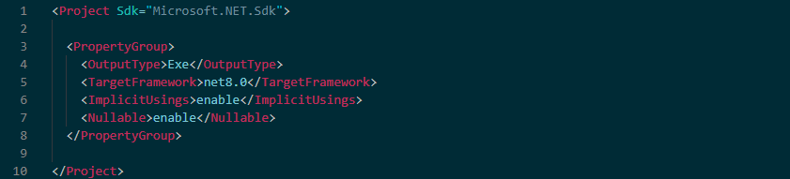
DOTNET.DOCKER CODE
Belgium Campus 2024/07/18 Cna 271

Slide 5
DOTNET.DOCKER CODE
Belgium Campus 2024/07/18 Cna 271

Slide 6
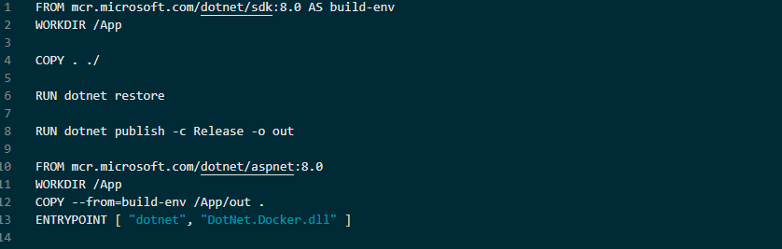
Dockerfile code
Belgium Campus 2024/07/18 Cna 271

Slide 7
Dockerfile code
Belgium Campus 2024/07/18 Cna 271

Slide 8
The end
Belgium Campus 2024/07/18 Cna 271

